Slide 1


DSCI 6004: Natural Language Processing
Names
1.Anjalipriya Rajulagari
2.Divya Mamuru

Slide 2
Medical Text Mining for Disease Detection using Natural Language Processing
Medical text mining has emerged as a powerful tool in healthcare for extracting valuable information from vast amounts of textual data. With the advancement of Natural Language Processing (NLP) techniques, it is now possible to leverage these technologies for disease detection and diagnosis based on clinical texts.
This proposal outlines a project to develop and implement a medical text mining system using NLP for disease detection.

Slide 3
Objectives
The primary objective of this project is to build a robust NLP-based system that can analyze medical texts, such as electronic health records (EHRs) and clinical notes, to identify and classify diseases accurately. Specific objectives include:
Developing NLP models for text preprocessing, feature extraction, and disease classification.
Integrating medical domain knowledge into the NLP models for improved accuracy.
Evaluating the performance of the system on real-world medical datasets.(https://www.helen-zhou.com/assets/pdf/emdot/paper.pdf)

Slide 4
Value Statement
The project on medical text mining for disease detection using Natural Language Processing (NLP) is highly valuable as it promises to enhance healthcare efficiency by automating disease diagnosis, thereby improving patient outcomes and reducing healthcare costs. By leveraging NLP techniques to analyze large volumes of medical text data such as electronic health records (EHRs) and clinical notes, this project aims to extract valuable insights that can inform medical decision-making, facilitate research and development in healthcare, and enable personalized medicine.
NLP-based disease detection systems act as vital decision support tools for healthcare professionals, contributing to early disease detection, targeted treatment plans, and effective public health management, ultimately leading to improved healthcare outcomes and enhanced patient care.

Slide 5
Approach
Data Collection: Gather a diverse dataset of medical texts, including EHRs, clinical notes, and medical literature.
Preprocessing: Clean and preprocess the text data to remove noise, standardize formats, and extract relevant features.
Feature Engineering: Use NLP techniques to extract features such as medical terms, symptoms, and disease mentions.
Model Development: Build and train NLP models, including BERT-based classifiers, to detect and classify diseases in the text.
Evaluation: Evaluate the performance of the models using metrics such as accuracy, precision, recall, and F1 score.
Integration: Integrate the NLP-based disease detection system into a user-friendly interface for healthcare professionals.

Slide 6
Data Cleaning and Pre-processing
Data cleaning for disease detection involves lowercasing text, removing punctuation and stopwords, spell checking, and handling abbreviations and acronyms.
Tokenization is essential, including word tokenization to split text into words and sentence tokenization to separate text into sentences for analysis.
Normalization techniques like stemming and lemmatization help reduce words to their base forms, aiding in consistent analysis.
Recognizing entities such as diseases, symptoms, medications, and procedures through named entity recognition (NER) is crucial for accurate detection.
Vectorization techniques like TF-IDF or word embeddings convert text into numerical vectors, enabling machine learning models to process and learn from the data.
Quality assurance ensures data accuracy and validity, including checks for imbalanced data and the creation of relevant features based on domain knowledge.

Slide 7
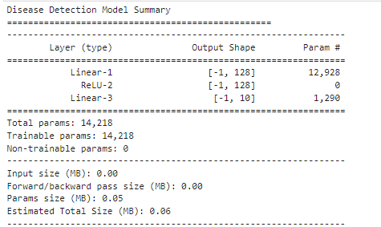
Models: Disease Detection Model

Slide 8
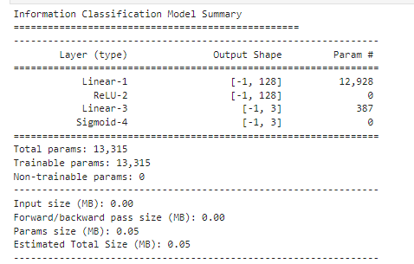
Models: Information Classification Model

Slide 9
Finetuning
Hidden Size: Set to 128.
Optimizer: Adam optimizer with a learning rate of 0.001.
Loss Function: CrossEntropyLoss.
Training Data: 80% of the data is used for training.
Testing Data: 20% of the data is used for testing after filtering out rows with labels not present in the training data.
Batch Size: Set to 32 for both the training and testing data loaders Shuffle: Data is shuffled for the training loader

Slide 10
Evaluation Methodology
Cross-validation: Validates model robustness by splitting the dataset into training and testing sets multiple times and evaluating performance across iterations.
Receiver Operating Characteristic (ROC) Curve: Plots the true positive rate against the false positive rate, aiding in assessing model sensitivity and specificity.
Area Under the Curve (AUC): Quantifies the ROC curve's performance, with higher values indicating better model discrimination ability.
Accuracy: Measures the overall correctness of disease predictions made by the NLP model. Precision evaluates the proportion of correctly identified disease cases among all cases predicted as positive by the model, while recall determines the proportion of correctly identified disease cases among all actual positive cases in the data. The F1 Score is the harmonic mean of precision and recall, providing a balanced measure of model performance. The confusion matrix visualizes the model's performance in terms of true positives, true negatives, false positives, and false negatives.
Comparison with baseline models and existing NLP-based disease detection methods.
Feedback from domain experts and healthcare professionals on system usability and accuracy.

Slide 11
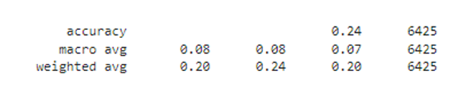
Results: Disease Detection Model
The accuracy of 0.24 suggests that the model is performing poorly in accurately classifying diseases. It correctly predicts only about 24% of the samples, which is significantly below a satisfactory level.
The macro average scores (precision, recall, and F1-score) are all very low, around 0.08 or 8%. This indicates poor performance across all classes, with the model struggling to distinguish between different diseases.
The weighted average scores are slightly higher than the macro average but still very low, around 0.20 for precision and F1-score and 0.24 for recall. Weighted average considers the class imbalance, but even with this adjustment, the model's performance remains inadequate.

Slide 12
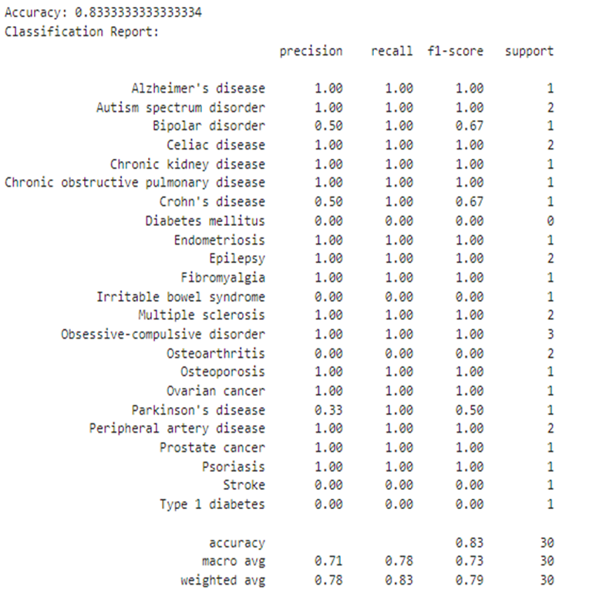
Results: Information Classification Model
The overall accuracy of 83% is quite good, especially considering the class imbalance in the dataset.
For classes such as Bipolar disorder, Crohn's disease, Diabetes mellitus, Irritable bowel syndrome, Parkinson's disease, Stroke, and Type 1 diabetes, where precision, recall, and F1-scores are low, the model struggles to classify these conditions accurately.
The weighted average F1-score of 79% indicates that there is room for improvement in overall model performance, particularly for classes with lower scores.

Slide 13
Deliverables
NLP Disease Detection Model: A fully trained NLP model for accurate disease identification from medical text data like EHRs or clinical notes.
Documentation and User Manual: Detailed documentation with deployment instructions for healthcare professionals and researchers.
Validation Metrics: Performance analysis including accuracy, precision, recall, and F1 score to showcase model effectiveness.
Research Paper: Summary of methodology, findings, and implications for medical informatics advancement.
Software Code: Accessible codebase with implementation scripts and tools for integration into existing systems.
Data Insights: Visualizations and insights from medical text data analysis, aiding healthcare decision-making.

Slide 14
Related Work
Brunekreef et al. [3] highlight the effectiveness of their text mining algorithm in diagnosing Systemic Lupus Erythematosus (SLE) with high accuracy, sensitivity, and specificity compared to assessments by medical experts. Their algorithm also outperforms previous algorithms used in similar studies. For example, Jorge et al. and Barnado et al. employed algorithms that processed structured parameters like ICD codes, laboratory results, and medication usage, achieving PPVs of 92% and 91% with sensitivities of 47% and 40% respectively.
Jorge et al. also developed a hybrid algorithm incorporating natural language processing, but its performance slightly lagged behind the structured-only algorithm with a PPV of 90% and sensitivity of 41%. A combined structured parameters and a lupus search term in EHR notes, yielding results comparable to studies without the search term (PPV 85% and 98%, sensitivity 97% and 84%). Despite the success of these machine learning models, their limited portability remains a challenge, although recent improvements have addressed this issue to some extent.

Slide 15
Related Work
Raparthi, Dodda, and Maruthi [1] in their abstract explore the synergy between Natural Language Processing (NLP) and Deep Learning (DL) techniques in the context of biomedical text mining, aiming to expedite the drug discovery process. Natural Language Processing, with its capacity to comprehend and interpret human language, serves as the foundational layer for extracting meaningful insights from biomedical texts. Leveraging advanced NLP algorithms, researchers can identify key entities such as genes, proteins, diseases, and their interactions, providing a comprehensive understanding of the biological landscape.
Nguyen et al. [2] conducted a critical analysis of 22 studies that utilized Deep Learning (DL) models to predict disease detection, subtype classification, and treatment responses using epigenomic data. The systematic review highlighted DNA methylation and RNA-sequencing as the most commonly employed data types for training predictive models. The reviewed models exhibited impressive accuracy, ranging from 88.3% to 100.0% for disease detection, 69.5% to 97.8% for subtype classification, and 80.0% to 93.0% for treatment response prediction. Furthermore, the article outlines a workflow for developing predictive models, encompassing tasks from defining disease-related objectives to evaluating model performance. DL demonstrates significant potential in extracting insights from extensive epigenomic datasets, thereby propelling translational epigenomics research forward.

Slide 16
References
M. Raparthi, S. B. Dodda, and S. Maruthi, "Biomedical Text Mining for Drug Discovery using Natural Language Processing and Deep Learning," Journal of Ballistics, vol. 35, no. 1, pp. 52-61, Dec. 2023. DOI: 10.52783/dxjb.v35.114.
T. M. Nguyen et al., "Deep Learning for Human Disease Detection, Subtype Classification, and Treatment Response Prediction Using Epigenomic Data," Biomedicines, vol. 9, no. 11, Nov. 2021, Art. no. 1733. DOI: 10.3390/biomedicines9111733.
T. E. Brunekreef et al., "Text Mining of Electronic Health Records Can Accurately Identify and Characterize Patients With Systemic Lupus Erythematosus," ACR Open Rheumatol., vol. 3, no. 2, pp. 65-71, Feb. 2021. DOI: 10.1002/acr2.11211.

